Slide 1

Developing Automatic System for Data Warehouse & Analysis
KIỀU THỊ HUYỀN TRANG
Aptech – DT2304L CLASS

Slide 2
Table Content
Data introduction
System overview
Component details
Programming
Final products

Slide 3
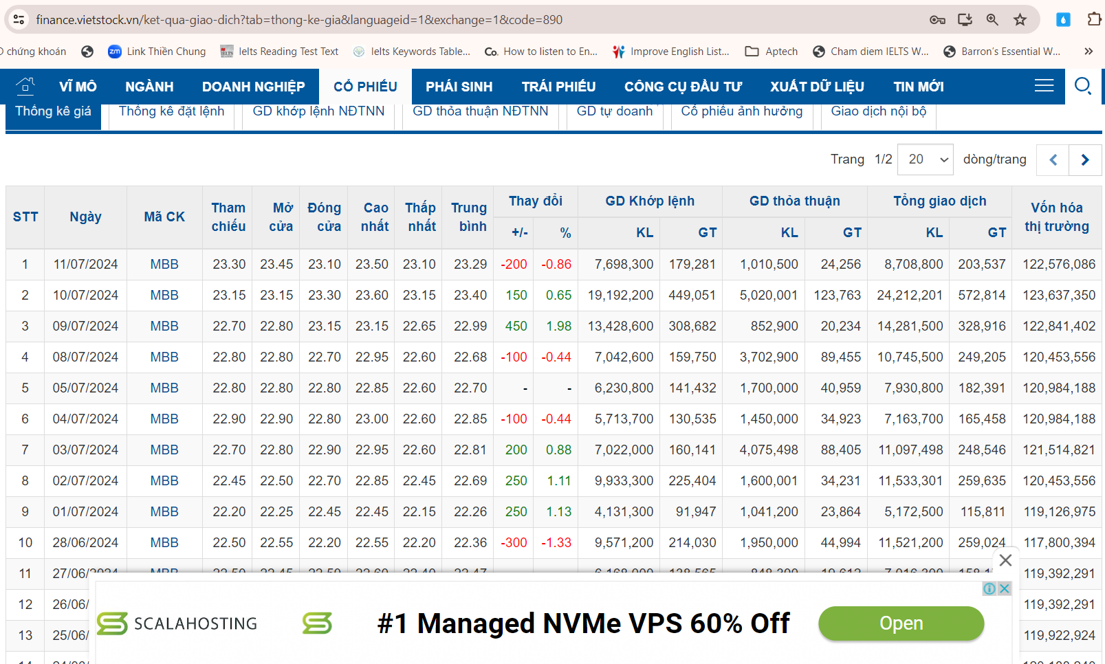
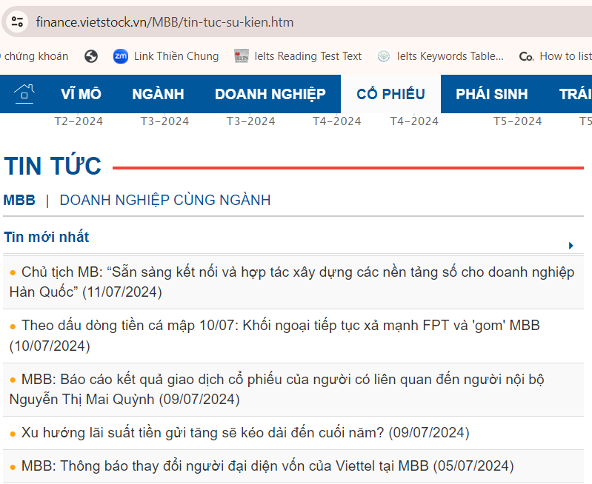
I. Data Introduction

Slide 4

II. System Overview
Airflow
Linux with Docker
Scrapy
MongoDB
Kafka
Spark
Postgres
MSSQLODBC18
SSAS
MSSQL
Web Data
sqlcmd
Visual Studio
Power BI
Microsoft
Windows

Slide 5
III. Component Details
Docker system
Scrapy
MongoDB
Kafka
Spark
Postgres
Ubuntu
Python 3.12.3
Selenium 4.4.3
MS Edge 126.0.2592.81
MongoDB 6.0.5
Confluentinc/ cp-kafka:7.2.2
Confluentinc/ cp-zookeeper:7.2.2
Python 3.12.3
Spark 3.5.1
JDK 22
Postgres 16
Adminer
Ubuntu 22.04

Slide 6
III. Component Details
Microsoft system
SSAS
Visual Studio 2022
SQL Server Management Studio
Power BI
MSSQLODBC
18
sqlcmd
Plugged-in analysis services
Design cube database
Interact directly with data
Dashboard tool
Connect Linux (Ubuntu 22.04) to SQL Server
SQL Server command-line tools for Linux

Slide 7
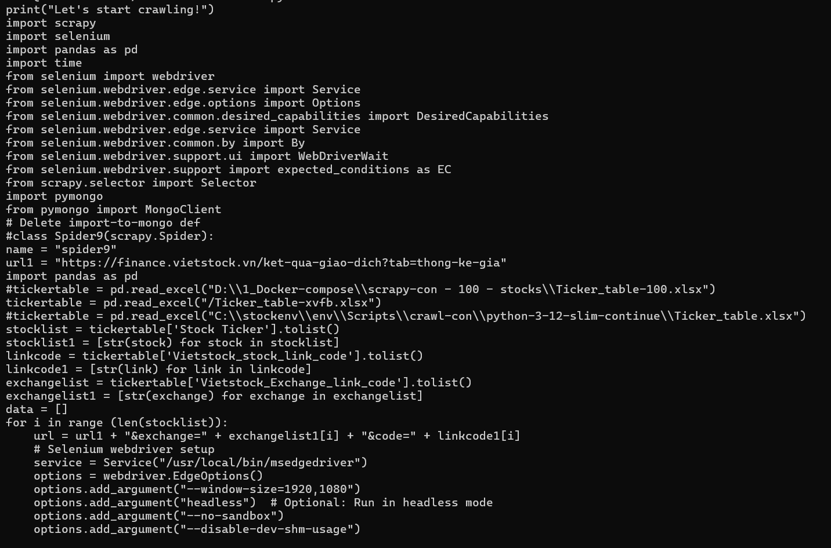
IV. Programming
Crawling data
Step 2
Writing data to Mongo DB
Step 1
Source codes: “dbstockcrawl.py”, “contentpubver3.py”

Slide 8
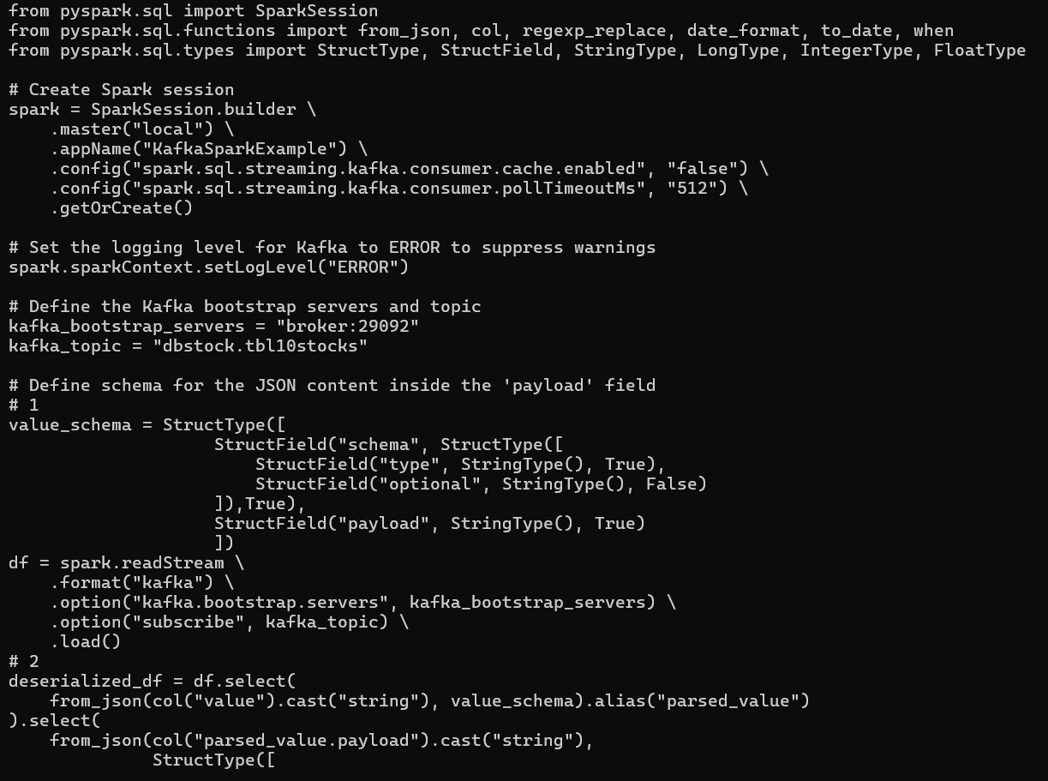
IV. Programming
Creating & registering Kafka topics
Step 4 - Kafka
Retrieving data from topics
Step 5 - Spark
Reading data from Kafka topics
Transforming & cleaning data
Step 3 - MongoDB
Writing data to Postgres
Source codes: “dbstockread.py”, “dbcontent-15.py”

Slide 9
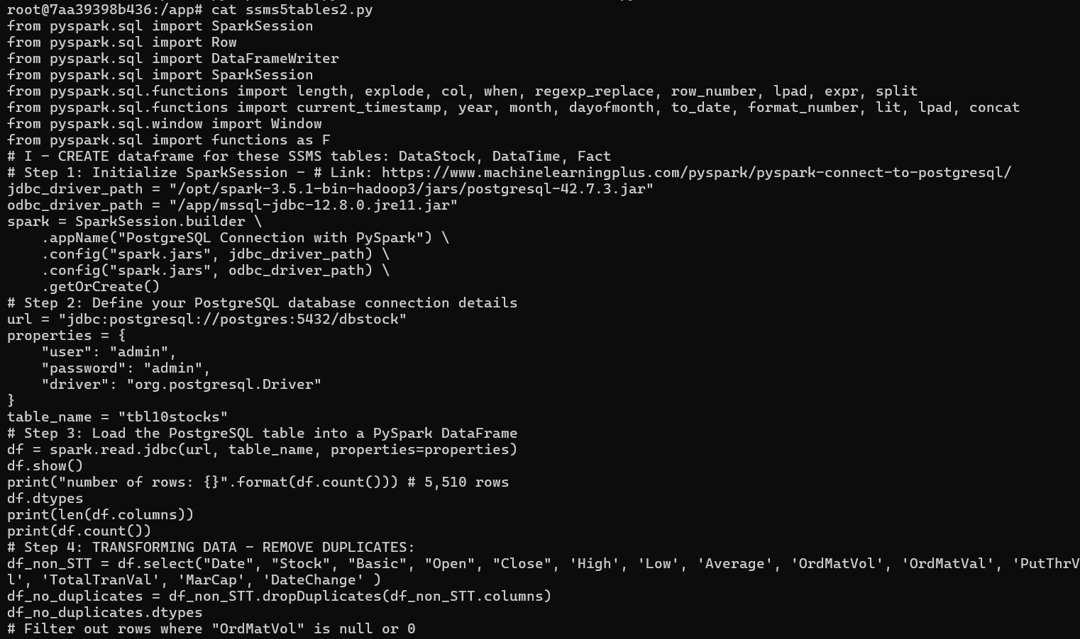
IV. Programming
Connecting PySpark to SSMS
Step 7 - SQLCMD
Creating SSMS database & tables
Step 8 - Spark
Creating data for SSMS tables
Writing data tables to SSMS
Step 6 – MSSQL ODBC
Source codes: “ssms5tables2.py”, “createstockdt.sql”

Slide 10
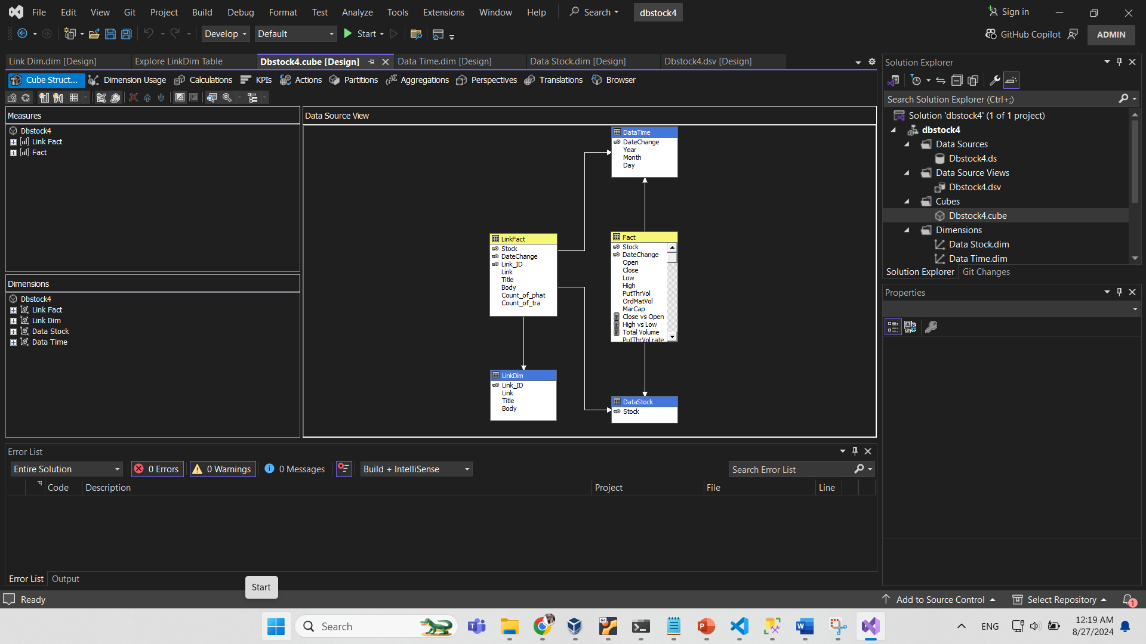
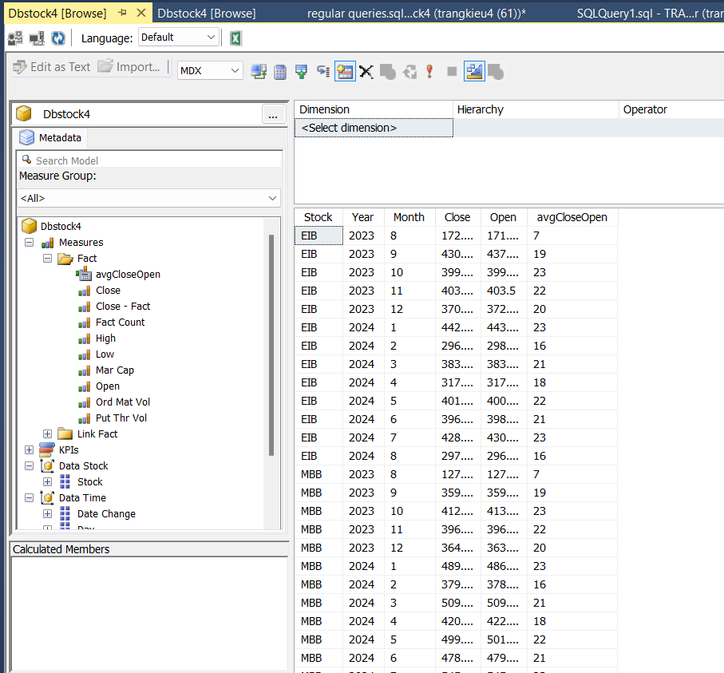
IV. Programming
Connecting SSMS & SSAS
Step 10 - SSAS
Pre-executing calculations in cube database
Step 9 – Visual Studio
Designing cube database
Source file: “dbstock4.sln”

Slide 11
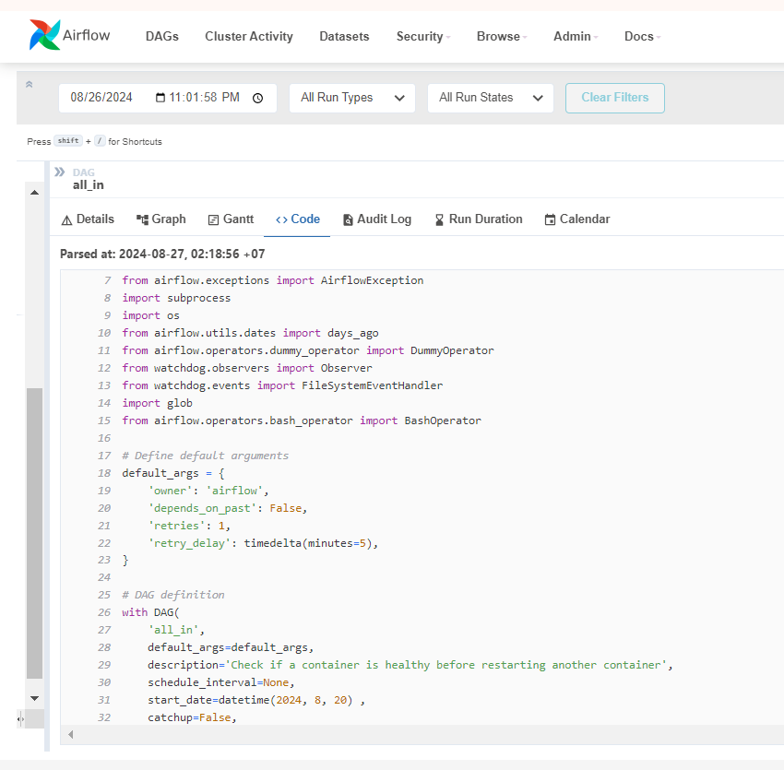
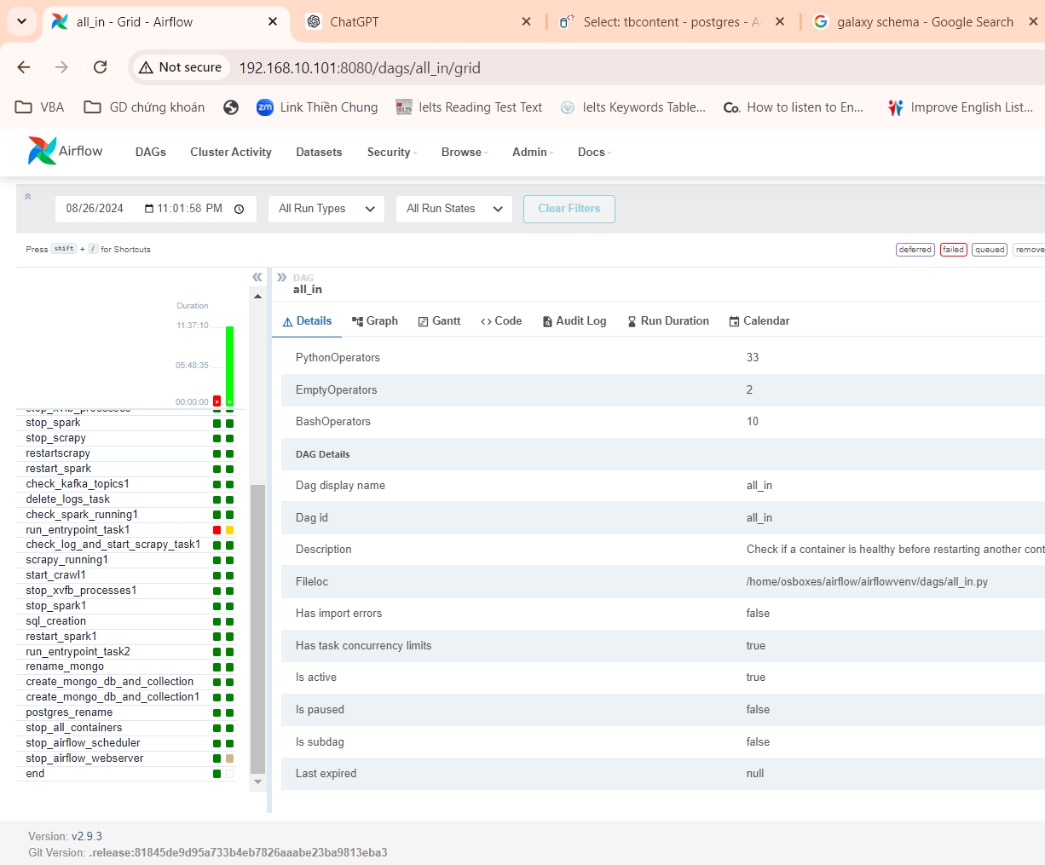
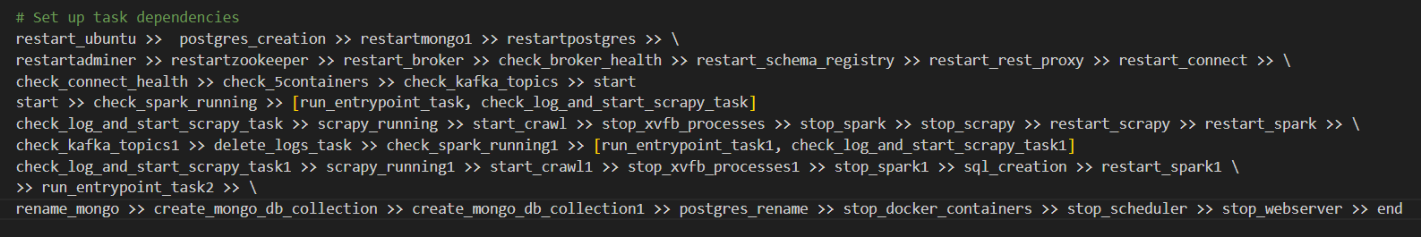
IV. Programming
All-in-one automatic process with Airflow
Source file: “all_in.py”

Slide 12
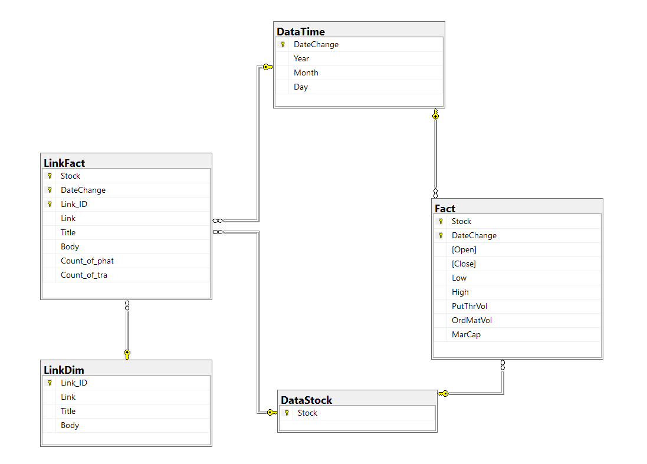
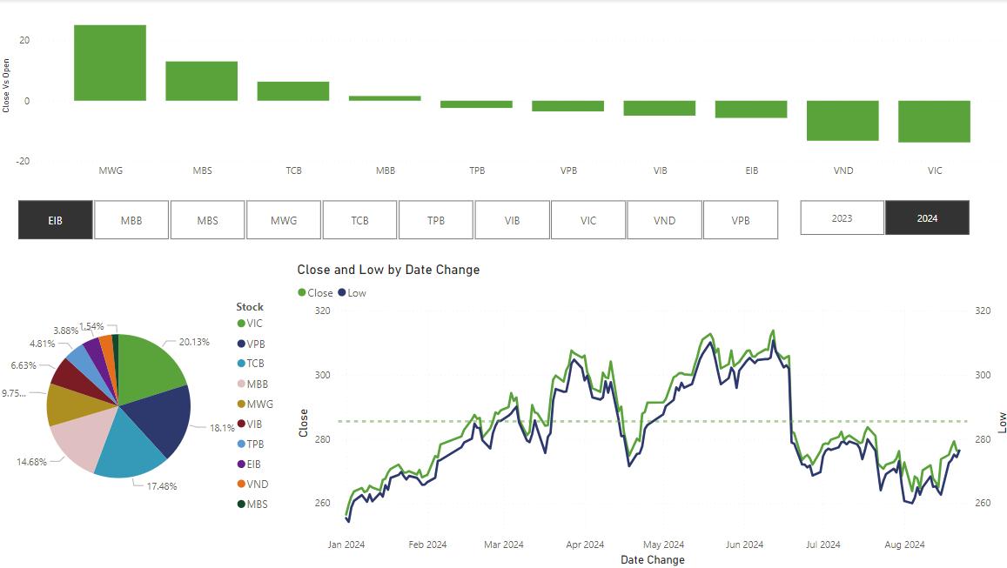
V. Final Products
Source file: “dbstock4-cube-Copy”

Slide 13

THANK YOU!
KIỀU THỊ HUYỀN TRANG

